Slide 1
SQL Query Generator

Slide 2
Goal
Based on user question and provided possible table names generate and execute SQL query and return result to the user

Slide 3
Steps
Set possible table names
Set user question
Get descriptions from database for selected table names
Use LLM to determine which table names are mentioned in user question based on possible table names, table descriptions, user question
Use mentioned table names together with their description and user question to generate SQL query using LLM
Execute query on database and get result
Use LLM to format response based on result and return it to user

Slide 4
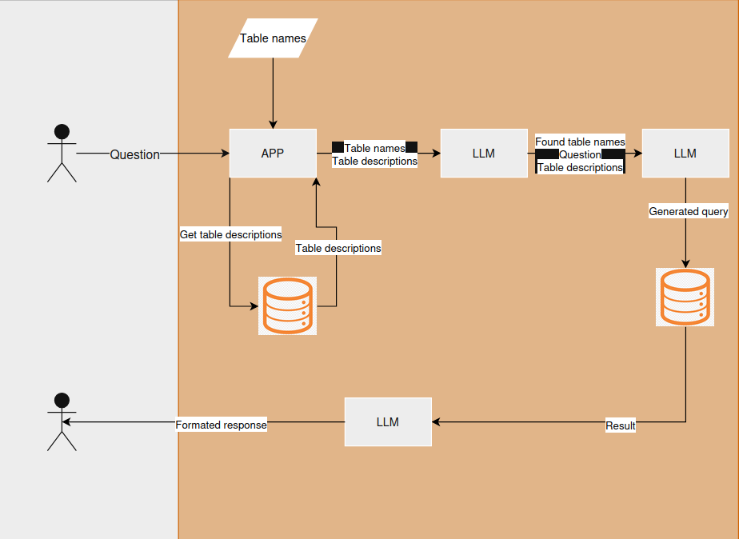

Slide 5
Examples
NOTE: to all queries LIMIT 10 is added to limit the number of rows in result since this is only for demo purposes

Slide 6
Example 1
Possible table names: change_management, grid_products, grid_material_information
Question: Which products from grid_products are linked to change request in change_management?
Found table names: change_management, grid_products
Generated SQL: SELECT gp.*
FROM qualanal.grid_products gp
JOIN qualanal.change_management cm ON gp.pr_id

Slide 7
Example 1
Formatted Response: The products from the grid_products table that are linked to change requests in the change_management table are as follows:
1. Product ID: 4278305 - Change Request: Ref BT CC #54200
2. Product ID: 5446332 - Change Request: N/A
3. Product ID: 679427 - Change Request: Ref BT CC #54200
4. Product ID: 8841480- Change Request: SLS - Paricalcitol
5. Product ID: 7302894- Change Request: N/A
6. Product ID: 5506806- Change Request: N/A
7. Product ID: 5060307 - Change Request: N/A
8. Product ID: 6715188 - Change Request: SFW - Wilson's Disease Drug Substance
9. Product ID: 7676853 - Change Request: KZO - Bevacizumab
10. Product ID: 8280027 - Change Request: KZO - Solu-Medrol
Please note that some change requests are marked as "N/A", indicating that no specific request is linked

Slide 8
Example 2
Possible table names: change_management, grid_products, grid_material_information
Question: Show me all changes from change management with their related materials.
Found table names: change_management, grid_material_information
Generated SQL: SELECT cm.*, gmi.*
FROM qualanal.change_management cm
JOIN qualanal.grid_material_information gmi ON cm.pr_id = gmi.pr_id;

Slide 9
Example 2
Formatted Response: The query returned several entries related to changes in the change management system,
specifically focused on the revision of the LAB-5008 method. Here's a summary of the key details:
1. Change ID: 1625044**
+*Description:** Revision of LAB-5008 to increase standard solution stability time.
⁃ +Status:** Closed
⁃ Justification:+t The working standard solution stability for folic acid was increased from 14
hours to 5 days for better Qc laboratory efficiency. The stock standard solution stability was
increased from 9 days to 11 days.
⁃ +Change Details: **
⁃ Addition of 0.5% sodium ascorbate in the diluent preparation.
⁃ Adjustments in the sample preparation while keeping core procedures intact.
⁃ Product Impact Analysis:' The change affects various products including multiple Centrum
formulations (e.g., Centrum Silver and Centrum Ultra) with specific item codes listed.
2. *Related Materials:
⁃ The documentation includes a detailed product impact analysis, describing how various
Centrum products are affected by the changes mede to the testing method LAB-5008.
I
⁃ The revisions include details on reagent preparations, method revisions, and note deletions
related to the standard solutions' stability.
This high-level overview captures the essence of the changes made in response to the
identified issues and highlights the significant implications for product quality control measures.
Hould you like more specific information about any related materials or technical details?

Slide 10
Example 3
Possible table names: change_management, grid_products, grid_material_information
Question: List all change requests and their product.
Found table names: change_management, grid_products, grid_material_information
Generated SQL: SELECT
cm.pr_id AS change_request id
cm.title_short_description AS change_request_title,
gp-product AS product name
FROM
qualanal.change_management cm LEFT JOIN qualanal.grid_products gp ON cm.pr_id - gp.pr_id;

Slide 11
Example 3
Formatted Response: Here are the change requests along with their corresponding products:
1. Change Request ID: 1000009
Product: マイラン製薬明 (ylan Lab Formulation)_メトホルミン塩酸塩綻5 0 0m_スケールアップ (3
2. Change Request ID: 1080007
Product: Update Inspection Interval for Danofloxacin 7 [1]
3. Change Reguest ID: 1000015
Product: (CUR) - TBD - PGM SCM C JFC Serialization Tech
4. Change Request ID: 1000016
Product: Stability Area Environmental Monitoring - Calibration Process Amendments.
5. Change Request ID: 1000020
Product: QTS Assignment Spreadsheet Updates - December 2014
6. Change Request ID: 1000024
Product: SOP - 24933 - Operation of Henkel #2
7. Change Request ID: 1000034
Product: TIER II : NPTL Modify EM_VSL_CHRG to include changes Hydrogenation.
8. Change Request ID: 1080937
Product: SOP - 24937- Preparation for Regenerating Eluate Beer Coluns
9. Change Request ID: 1300845
Product: Tier II OSP1 Update PRESTSTI sequence to ensure operator correctly posted regarding vessel selected for operation
10. Change Request ID: 1000049
Product: Supply of Newbridge Manufactured Rapamune Bulk to Argentina
(Note: All products listed have a corresponding request ID, but some
have a product name listed as None-)

Slide 12
Example 4
Possible table names: change_management, grid_products, grid_material_information
Question: Find change requests with their responsible departments and related products.
Found table names: change_management, grid_products
Generated SQL: SELECT
cm.pr_id,
cm.title_short_description,
cm.responsible_department
gp.device_combination_product
FROM
qualanal.change_management cm
LEFT JOIN qualanal.grid products gp ON cm.pr_id = gp.pr_id;

Slide 13
Example 4
Formatted Response: Here are the change requests along with their responsible departments and related products:
1. **Change Request ID:*+ 1(0)006
**Product:** マイラン製薬朝_ (ylan Lab Formulstion)_メトホルミン塩酸塩綻5 0 0mg_スケールアッブ (3
**Department:** TYO - 品質保証統括部
"`Related Product:** None
2. **Change Request ID:"* 1000007
+*Product:** Update Inspection Interval for Danofloxacin 7 [1]
**Department:** RNG - Quality Control
**Related Product:** None
3. Change Request ID:** 1000015
**Product:'* (CUR) - TBD - PGM SCM C JFC Serialization Tech
**Department:** KZO - 2215515 Bldg 41 Warehouse (4K752)
*Related Product:'* None
4. **Change Request ID:** 1000016
•#Product:' Stability Area Environmental Monitoring - Calibration Process Amendments.
"'Department:* PSI - Global Procurement and Operations
**Related Product:** None
5. Change Request ID:" 1080020
"'Product:** QTS Assignment Spreadsheet Updates - December 2014
-+Department:+* K20 - 2214124 Q0 Bus Sys & Validat (4K562)
**Related Product:** None
… (there is more)

